Slide 1
Database Normalization
PHP Quebec 2005
Mike Hillyer – MySQL AB
Notes:
Mike Hillyer
Technical writer for MySQL AB, MySQL Core and Pro certified.
This session has been delivered to the Lethbridge MySQL Group and will also be delivered at the PHP Quebec conference.

Slide 2
About Me
Mike Hillyer, BSc
Member of the MySQL AB documentation team
MySQL Core and Pro Certified
Top MySQL expert at www.experts-exchange.com
Resident MySQL expert at SearchDatabase.com
http://www.openwin.org/mike/aboutme.php
Notes:
I’m Mike Hillyer from Alberta Canada.
Here’s some qualifications for those who are interested.

Slide 3
About You
How many of you…
Currently use MySQL?
Another RDBMS?
Are responsible for database design?
Will be in the future?
Know about database normalization?
Notes:
Those using another DB are forgiven ;)
We’ll be started with a look at the most common model, followed by an introduction on a better approach.

Slide 4
About This Session
http://www.openwin.org/mike/presentations/
http://dev.mysql.com/tech-resources/articles/intro-to-normalization.html
Introduction
What Is Database Normalization?
What are the Benefits of Database Normalization?
What are the Normal Forms?
First Normal Form
Second Normal Form
Forming Relationships
Third Normal Form
Joining Tables
De-Normalization
Conclusion
Notes:
If you want to follow along, you can find the slides for this presentation at openwin.org, the article this session was based on is at vbmysql.com

Slide 5
What Is Database Normalization?
Cures the ‘SpreadSheet Syndrome’
Store only the minimal amount of information.
Remove redundancies.
Restructure data.
Notes:
Many new database developers suffer from the ‘spreadsheet syndrome’, creating as few tables as possible, often just a single table. They place dozens of columns in their table, to try and cover every possible piece of data, even though they often leave most columns unfilled for a given row.
By contrast database normalization aims to store the smallest amount of info possible in each table, leaving no columns that are filled for just a few of the rows. In fact, in a properly normalized table there should be very few empty(NULL) fields.
This is accomplished by restructuring the data into multiple tables, with each table containing a subset of the information.

Slide 6
What are the Benefits of Database Normalization?
Decreased storage requirements!
1 VARCHAR(20)
converted to 1 TINYINT UNSIGNED
in a table of 1 million rows
is a savings of ~20 MB
Faster search performance!
  Smaller file for table scans.
  More directed searching.
Improved data integrity!
Notes:
And hey, odds are you can change more than one column, and you may have more than a million rows.

Slide 7
What are the Normal Forms?
First Normal Form (1NF)
Second Normal Form (2NF)
Third Normal Form (3NF)
Boyce-Codd Normal Form (BCNF)
Fourth Normal Form (4NF)
Fifth Normal Form (5NF)
Notes:
Normal forms above 3NF are mainly for academics, and are not seen very often in the wild.

Slide 8
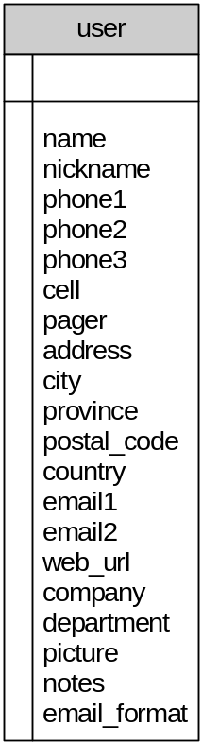
Our Table
name | phone1 | phone2 | email1 | email2
Mike Hillyer | 403-555-1717 | 403-555-1919 | mike@hoppen.com | mhillyer@mysite.com
Tom Jensen | 403-555-1919 | 403-555-1313 | tom@openwin.org | tom@supersite.org
Ray Smith | 403-555-1919 | 403-555-1111 | ray@cpma.com

Slide 9
First Normal Form
Remove horizontal redundancies
  No two columns hold the same information
  No single column holds more than a single item
Each row must be unique
  Use a primary key
Benefits
  Easier to query/sort the data
  More scalable
  Each row can be identified for updating
Notes:
Back to original table, our phone columns are redundant, our name field holds more than one piece of info, we have redundant email addresses. And even the cell and pager info is redundant in the sense that they are both phone numbers to reach you at.

Slide 10
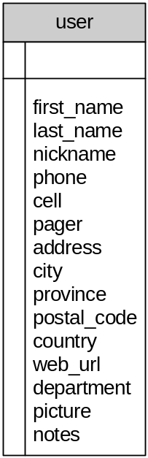
One Solution
first_name | last_name | phone | email
Mike | Hillyer | 403-555-1717 | mike@hoppen.com
Mike | Hillyer | 403-555-1919 | mhillyer@mysite.com
Tom | Jensen | 403-555-1919 | tom@openwin.org
Tom | Jensen | 403-555-1313 | tom@supersite.org
Ray | Smith | 403-555-1919 | ray@cpma.com
Ray | Smith | 403-555-1111
Multiple rows per user
Emails are associated with only one other phone
Hard to Search

Slide 11
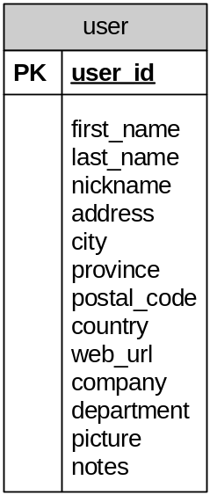
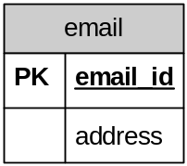
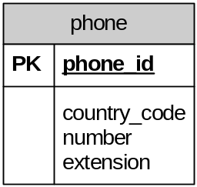
Satisfying 1NF
Notes:
We now have three tables. In our phone table, instead of just having the phone number in a column we split it into country code, number, and extension. If we were really ambitious we could even split off the area code, but it depends on what you need to do with the data.
Each table has a primary key so that each row can be uniquely identified. The email and phone tables have ID primary keys, and the user also has a user_id.
I’ll talk about how to associate these tables next.

Slide 12
Forming Relationships
Three Forms
  One to (zero or) One
  One to (zero or) Many
  Many to Many
One to One
  Same Table?
One to Many
  Place PK of the One in the Many
Many to Many
  Create a joining table
Notes:
Before we relate these tables, lets look at the different types of relationships that exist:
In our case, the email table can just contain the user_id from the user table, indicating which user it belongs to. This will be combined with the address itself to form a composite primary key.
The phone on the other hand is a many-to-many. One person can have several numbers, and multiple people can share the same number.

Slide 13
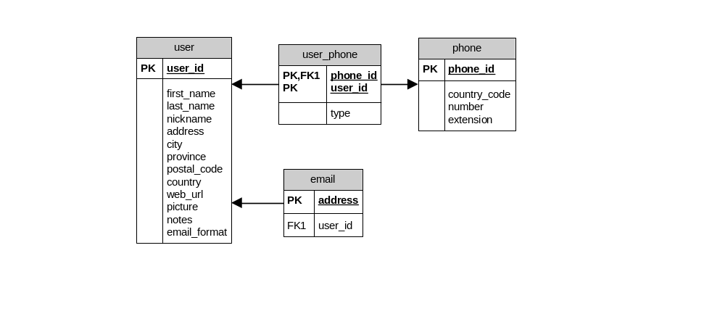
Joining Tables
Notes:
Because we can have one phone number shared by many people, and a person can have many phone numbers, we are going to create a joining table between them.
Our email addresses are considered unique, and because each address has one user, we place the primary key of the user in the email table as a foreign key.

Slide 14
Our User Table
first_name | last_name | company | department
Mike | Hillyer | MySQL | Documentation
Tom | Jensen | CPNS | Finance
Ray | Smith | CPNS | Documentation

Slide 15
Second Normal Form
Table must be in First Normal Form
Remove vertical redundancy
  The same value should not repeat across rows
Composite keys
  All columns in a row must refer to BOTH parts of the key
Benefits
  Increased storage efficiency
  Less data repetition
Notes:
So, we need to remove the vertical redundancy of the company name, and the type column in the joining table violates 2NF, the type has more to do with the phone line than with the user and phone together.

Slide 16
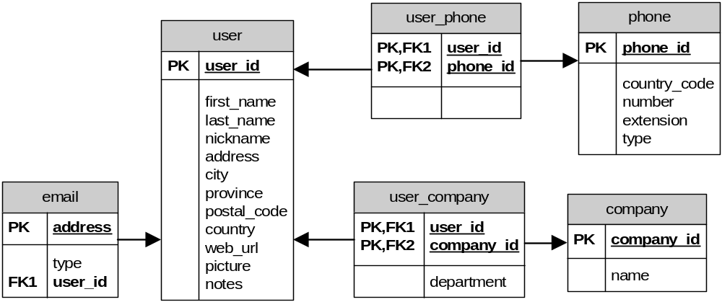
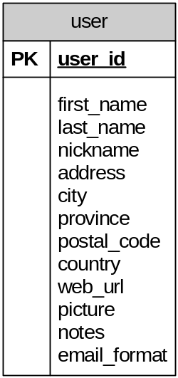
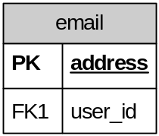
Satisfying 2NF
Notes:
We now have a user/company table, with the department included since the department relates to the combination of user and company.

Slide 17
Third Normal Form
Table must be in Second Normal Form
  If your table is 2NF, there is a good chance it is 3NF
All columns must relate directly to the primary key
Benefits
  No extraneous data

Slide 18
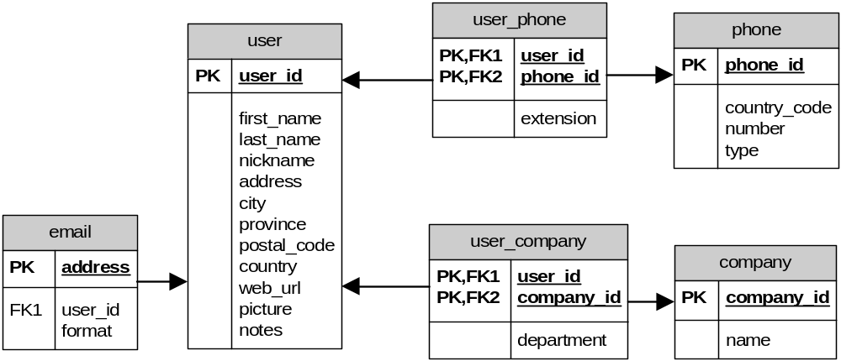
Satisfying 3NF
Notes:
There are a few places we can see potential 3NF violations:
The phone extension is going to be different for each person in an office, and it not a property of the phone itself, so lets move it to the user_phone table.
The email format, while often considered specific to a user, is probably more a property of the email address. Some may like text at work and tolerate HTML at home.

Slide 19
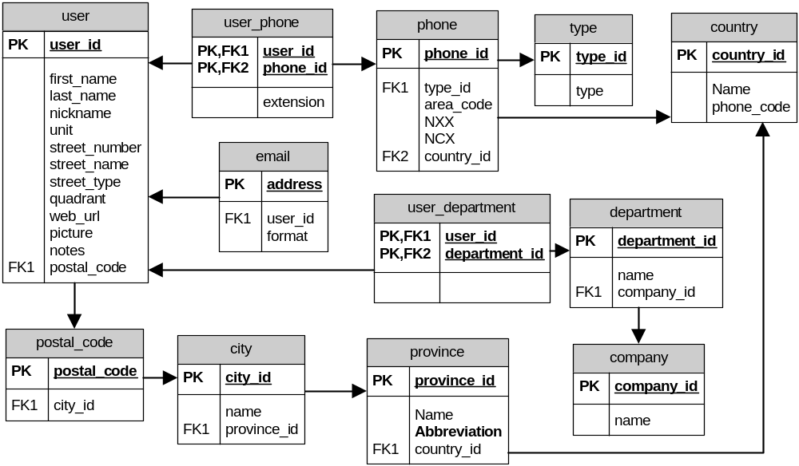
Finding Balance

Slide 20
Joining Tables
Two Basic Joins
  Equi-Join
  Outer Join (LEFT JOIN)
Equi-Join
  SELECT user.first_name, user.last_name, email.address
  FROM user, email
  WHERE user.user_id = email.user_id
LEFT JOIN
  SELECT user.first_name, user.last_name, email.address
  FROM user LEFT JOIN email
  ON user.user_id = email.user_id

Slide 21
De-Normalizing Tables
Use with caution
Normalize first, then de-normalize
Use only when you cannot optimize
Try temp tables, UNIONs, VIEWs, subselects first

Slide 22
Conclusion
http://dev.mysql.com/tech-resources/articles/intro-to-normalization.html
MySQL Database Design and Optimization
  Jon Stephens & Chad Russell
  Chapter 3
  ISBN 1-59059-332-4
  http://www.openwin.org/mike/books
http://www.openwin.org/mike/presentations

Slide 23
QUESTIONS?
Feel free to ask now or find me after this session!

Slide 24
Book Draw!
Stick around and win a book!

